Slide 1

TEXAS STATE UNIVERSITY McCoy College of Business Administration Department of Computer Information Systems & Quantitative Methods QMST 5335 - Forecasting and Simulation Spring 2021
Project Presentation
Team – 5
Dan Darden
Pooja Priya
Akshitha Karthick Kumar
Muhammed Ashraf

Slide 2
Outline:
System Explanation
Input Data Analysis
SIMIO Model – Design and Verification
Comparison Results
Recommendations

Slide 3
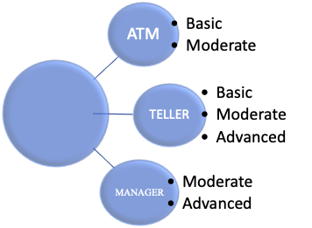

System Explanation
Bank system has 3 types of customers:
1. BASIC
2. MODERATE
3. ADVANCED
Customers arrives at SignIn station where one Bank
employee navigate them to either ATM, TELLER and MANAGER .
Figure shows types of customers
going to different stations. (ATM, TELLER and MANAGER)

Slide 4
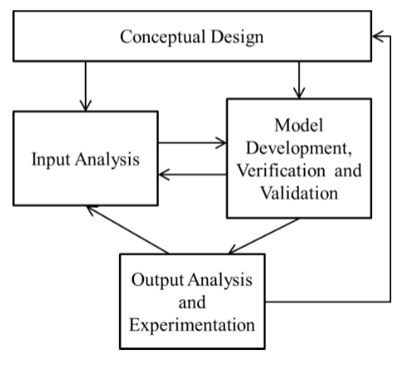
Simulation Process - Flowchart

Slide 5
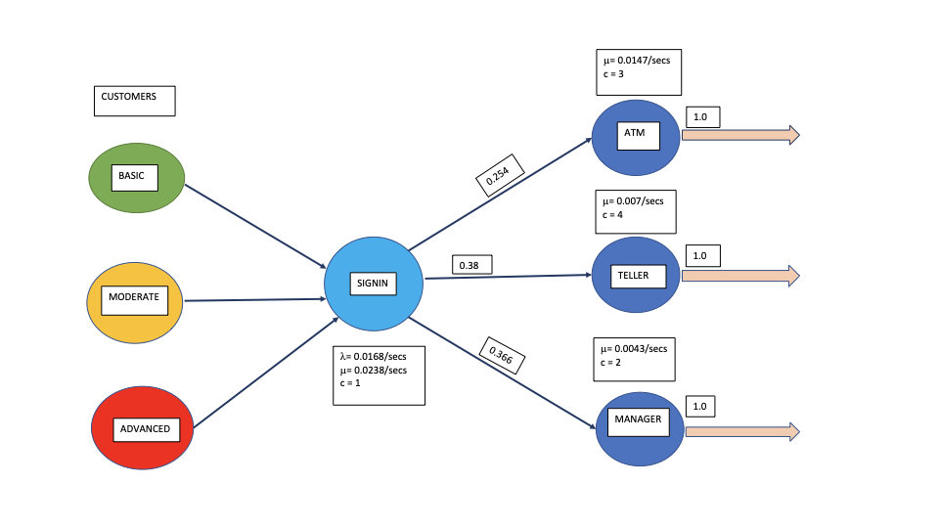
Conceptual Design – Jackson Network
Input Data taken from Team 5 sheet of Project 3–Data.xlsx
The data is Stochastic, Dynamic and Continuous and so is the Simulation type.
A Jackson Network is created with the Mean Inter-arrival and Service times calculated from the given data.
Customers are served on 'First Come and First served basis '.

Slide 6
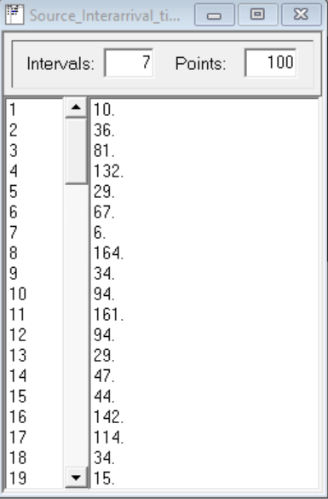
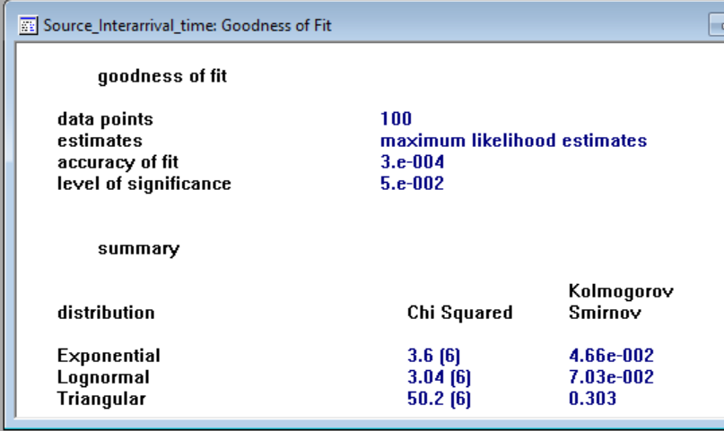
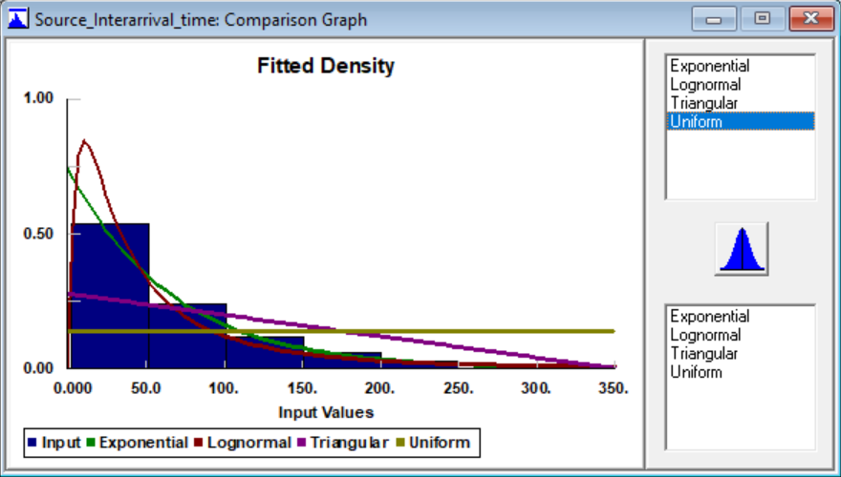
Input Analysis: Using Stat -fit
Fitted Distribution for the Source:
Mean Interarrival time = Random.Exponential(66.3)
Fitted Distribution for Signin station: Triangular(0, 85.3, 41.8)
Service time = Random.Exponential(42.3)

Slide 7
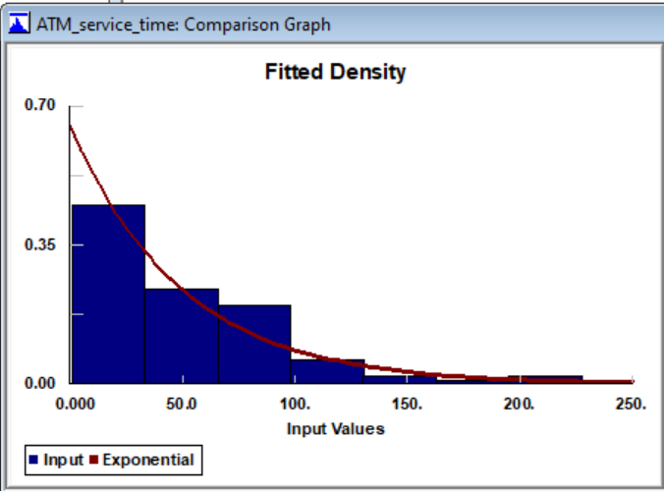
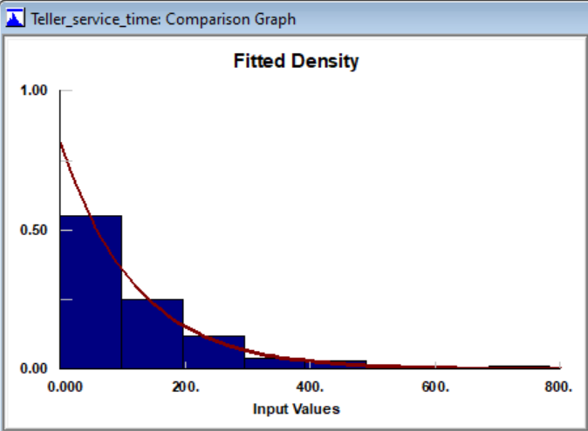
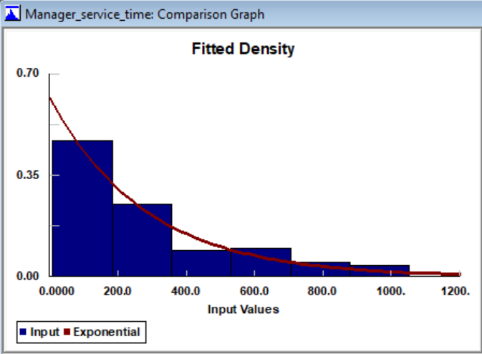
Fitted Distribution and Expressions for Processing Time
The service time for ATM, Teller and Manager Stations are Exponentially distributed:
ATM station: Random. Exponential(49.4) Teller station: Random.Exponential(119) Manager station: Random. Exponential(280)

Slide 8
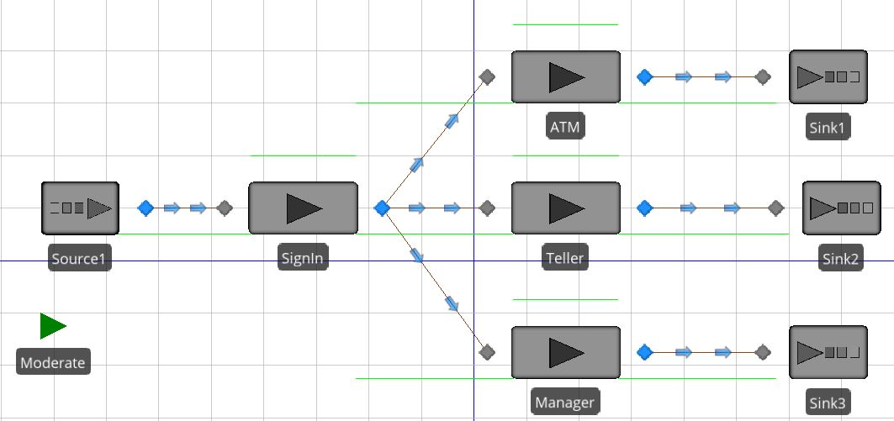
Verification Model
Verification model for Moderate type customers
With
Run-length = 5000*66.3=331500 sec
Warm-up Period = 500*66.3=33150 sec
Replications = 100
Table: Comparison of 92-hour Simulation Run and Theoretical Results
Metric | Queueing | Simulation Run
Utilization (ρ) | 0.71 | 0.7086
AverageNumberInSystem (L) | 5.332 | 5.26
AverageTimeInSystem (W) | 344.89 | 311.961
AverageTimeInQueue (W_{q}) | 129.92 | 137.035

Slide 9
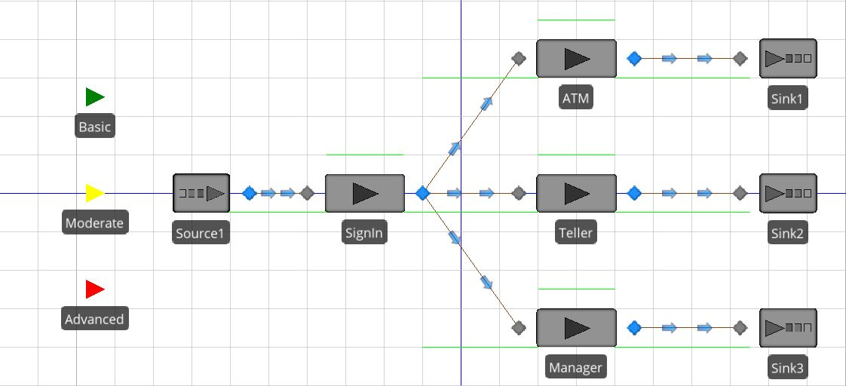
Model Development
SIMIO Experimental Model

Slide 10
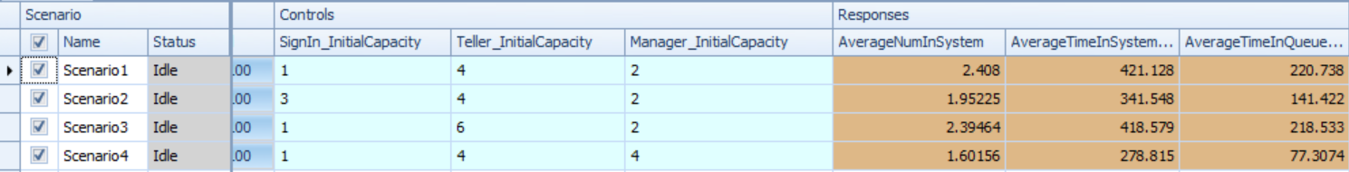
Scenarios and Responses
Scenarios:
1 employee at signin, 4 tellers & 2 managers. (Current Staffing levels)
Scenario A : 2 sign-in employees, 0 teller, 0 manager
Scenario B : 0 sign-in employee, 2 tellers, 0 manager
Scenario C : 0 sign-in employee, 0 teller, 2 managers
Responses:
Average number of customers in the bank, Average time a customer is in the bank & Average time each customer spends waiting for service.

Slide 11
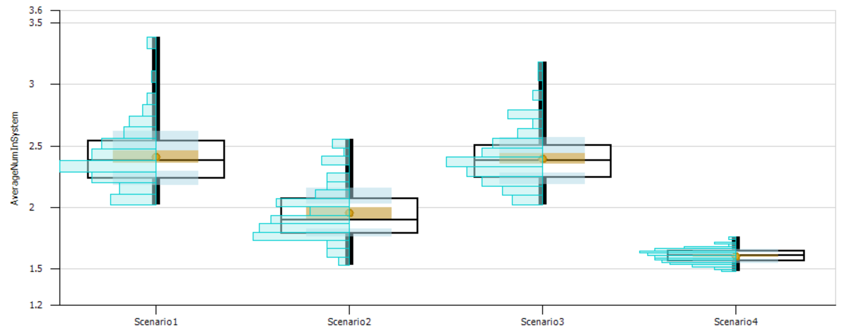
Output Analysis
SMORE plot for AverageNumberInSystem:

Slide 12
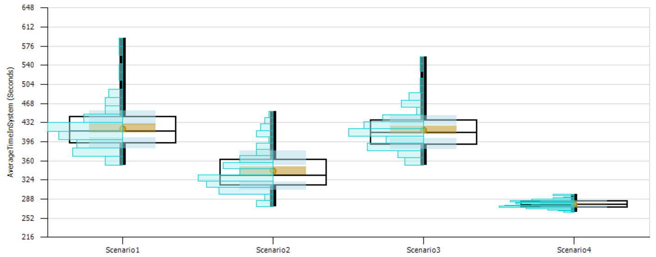
SMORE plot for AverageTimeInSystem (Seconds):

Slide 13
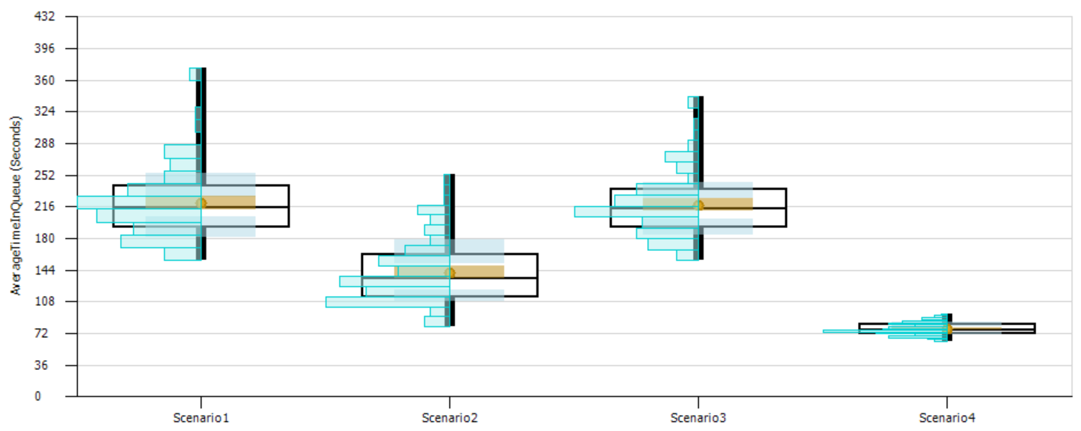
SMORE plot for AverageTimeInQueue (Seconds):

Slide 14
Recommendations based on Experimentation
Add 2 additional managers.
Average number of customers in the bank is reduced. (Response 1)
Average time each customer spends in the bank is reduced. (Response 2)
Average time each customer spends waiting for service at each station is reduced. (Response 3)
Why?
The utilization of each manager is greatly reduced.
Customers seeing the manager made up 30% of the customers but had the longest average service time.
The queueing time for each customer seeing the manager was reduced.
The addition of employees at the other stations did not have the same impact on the response variables as adding 2 additional managers.

Slide 15
Q&A

